Slide 2
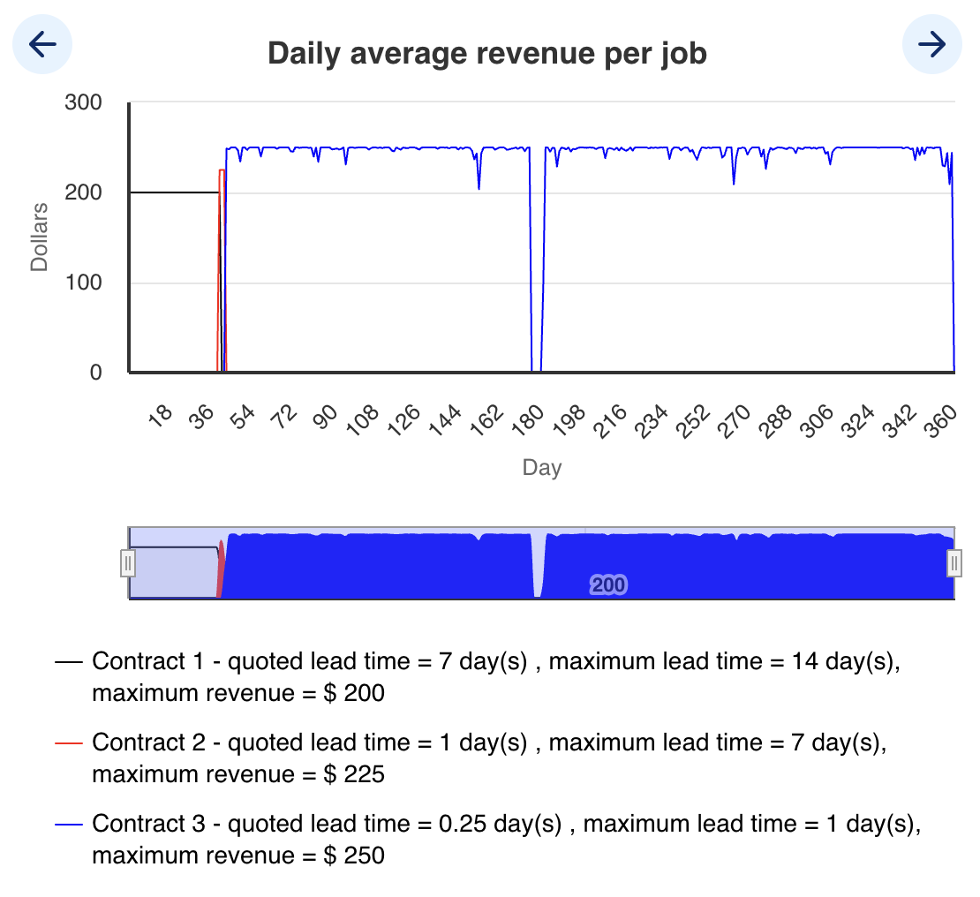
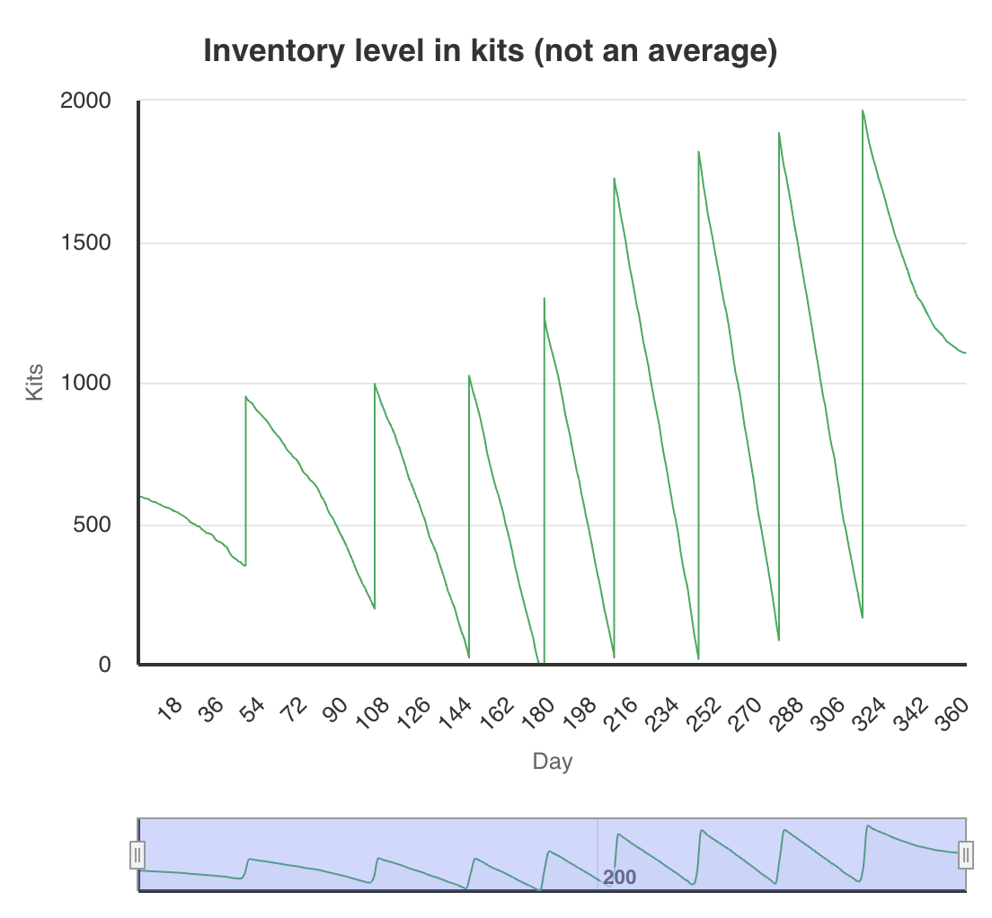
Team B (6th place)
Cash: $1,615,687
S1: 1 → 2 (day 33) → 3 (day 38) → 4 (day 39) → 5 (day 97) → 6 (day 130) → 7 (day 156) → 8 (day 163) → 9 (day 220) → 10 (day 233) → 11 (day 254) → 10 (day 328) → 8 (day 329) → 7 (day 334) → 5 (day 338) → 3 (day 343) → 2 (day 354) → 1 (day 355)
S2: 1 → 2 (day 86) → 3 (day 196) → 2 (day 331) → 1 (day 340)
S3: 1 → 2 (day 218) → 1 (day 235)
1. Capacity Management
- S1: util >95% by day 22 but ramped 1→11 too fast—should add one at util >90% (~day 20) and trim when util <70% (~day 260).
- S2: add at util >80% (~day 86), sell when util <40% (~day 330).
- S3: added at util <60%—should add only if util >90% (never reached).
2. Contract Strategy
Switched to C3 ($250/job) by day 42; early S1 shortage (days 1–33) forced some C2/C1 fills. Maintaining two S1 machines by day 20 would support uninterrupted C3 until day 175.
3. Inventory Performance
- Stockouts around days 174.7–176.9 during peak C3 demand.
- Leftover ≈1 106 kits (~$110,600)
Revenue
Inventory

Slide 3
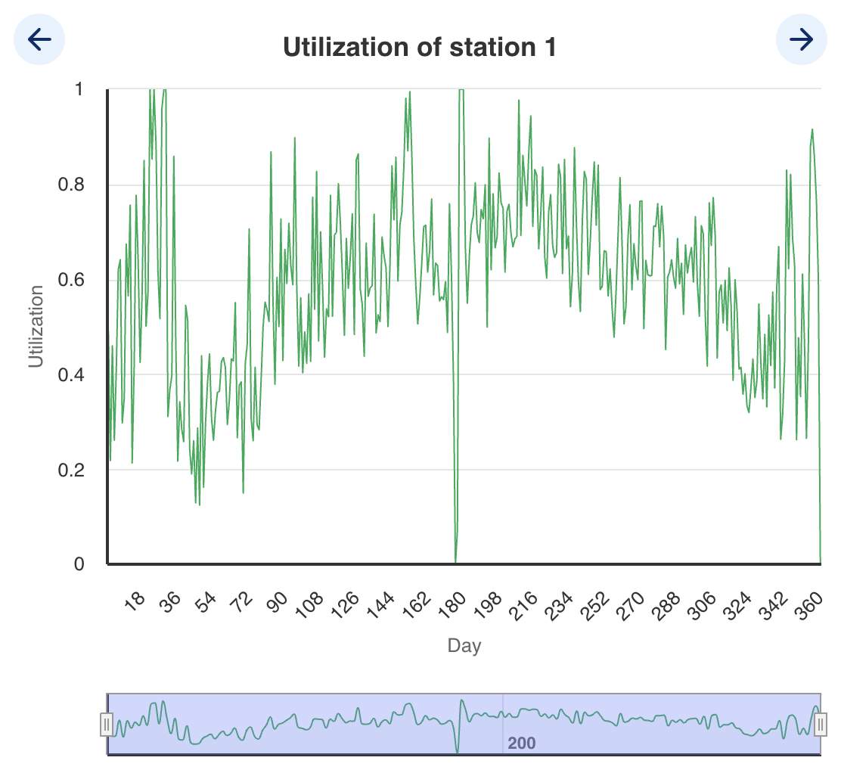
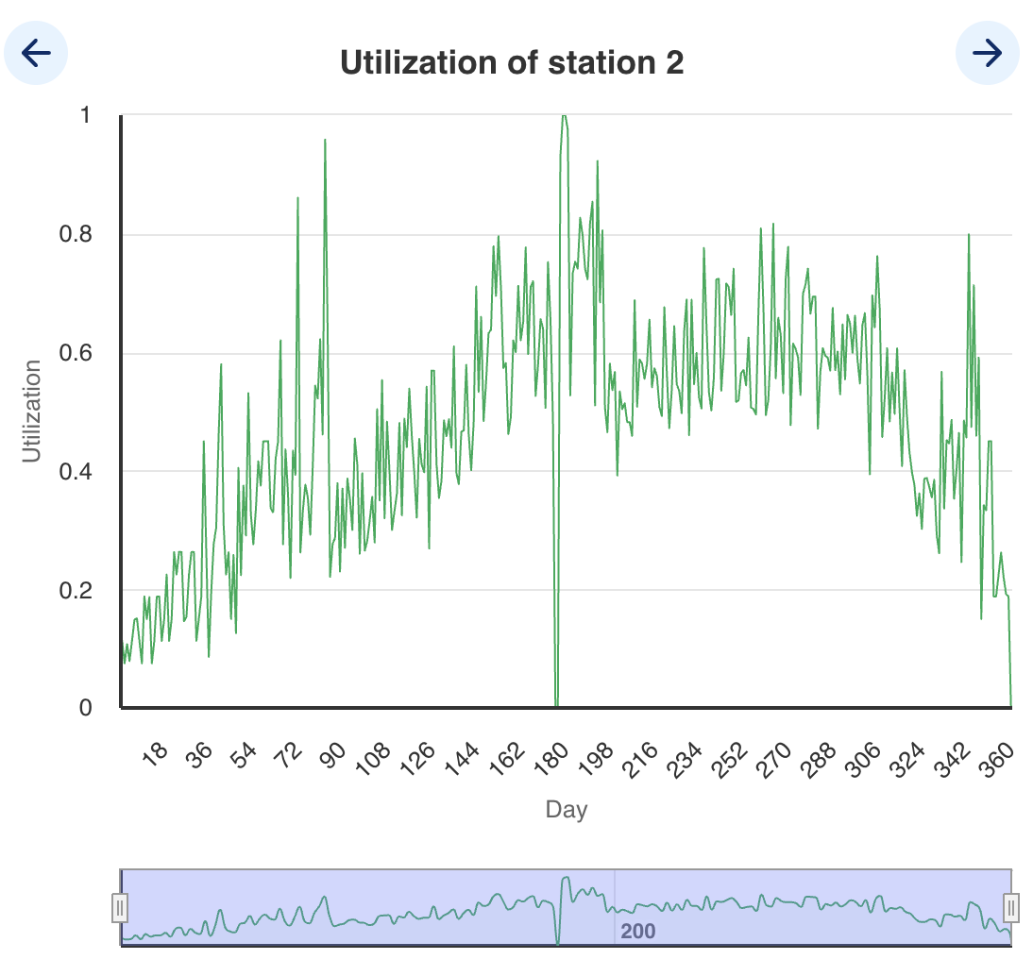
Utilization
Station 1
Station 2

